Slide 1

State of New Mexico
Production Equipment Ad Valorem Tax
February 2018

Slide 2
Agenda
Statute review: 7-34 NMSA, 1978
Master Operators
Severance Tax Reporting
Preliminary Value Verification Notice
Oil and Gas Equipment Tax (OGET)and Oil and Gas Annual Ad Valorem Tax Roll Distribution (OGAA)
Ad Valorem Production Tax Rates
Ad Valorem Equipment Tax Assessment

Slide 3
Oil and Gas Production Equipment Ad Valorem Tax
Statutes: NMSA 1978
7-34-2.C Definitions
7-34-3 Method of determining assessed value
7-34-4 Ad Valorem tax levied
7-34-6 Tax Statement; Tax due date
7-38-32 Department to prepare a compilation of net taxable values to be used for budget making and rate setting.
7-38-33 Department of Finance and Administration to set tax rates

Slide 4
7-34-5 Oil and Gas Production Equipment Ad Valorem tax to be exclusive measure of Ad Valorem tax liability
The tax levied by section 7-34-4 NMSA 1978 shall be the full and exclusive measure of Ad Valorem tax liability for equipment used at a production unit for the calendar year 1969 and all subsequent years. Any other Ad Valorem tax on equipment used at a production unit is void.

Slide 5
Master Operator 7-34-2
Registered with the Oil Conservation Division
The Master Operator is responsible for filing form C115 with the Oil Conservation Division.
Per statute, well operator means any person engaged in the severance of products from a production unit.
Operators who sever and sell products to other parties may not always be responsible for filing Oil and Gas Severance taxes based on their agreements and or contracts.

Slide 6
Oil and Gas Severance Tax reporting
All products upon leaving the lease are considered severed and sold.
All production can be reported under the respective parties OGRID (Oil and Gas Remitter Identification Number) or by interest owners and purchasers.
Amendments to the prior calendar year production reported are taken into consideration.
As a result, the system is compiling the data to produce the Preliminary Value Verification Notice for Master Operators.

Slide 7
Preliminary Value Verification Notice
(PVVN)
The preliminary value verification notice is issued in April each year to the Master Operator at a point in time.
Operators will be assessed the value of all production reported against their properties (PUN’s) by all parties that report on their properties.
Operators should confirm the PUN’s and the review the values for accuracy.
Anomalies or discrepancies must be addressed and resolved by the Operator on or before the September due date annually.

Slide 8
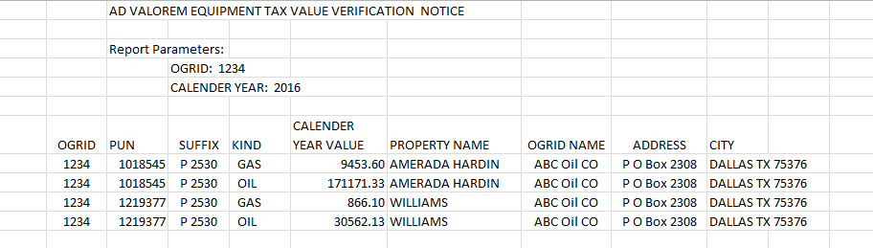
Ad Valorem Equipment Tax Value Verification Notice Example:

Slide 9
Addressing PVVN Discrepancies
Properties sold: the Operator must work with the Oil Conservation Division to transfer the property to the new Operator.
Properties purchased: if the property is purchased prior to the issuance of the assessment, the new Operator will be assessed the current year Production Equipment Ad Valorem Tax.
The department will not revise and reissue the assessment should discrepancies be reported past the issuance date.

Slide 10
Oil and Gas Equipment Tax (OGET)
Distribution Report 7-38-32
The Oil and Gas Equipment Ad Valorem report is based on distributions of issued and paid assessments for the previous calendar year.
The report is distributed to the producing counties and school districts in April annually.
The report is distributed via email based off of the distribution list of the prior year. Hard copies are not provided.

Slide 11
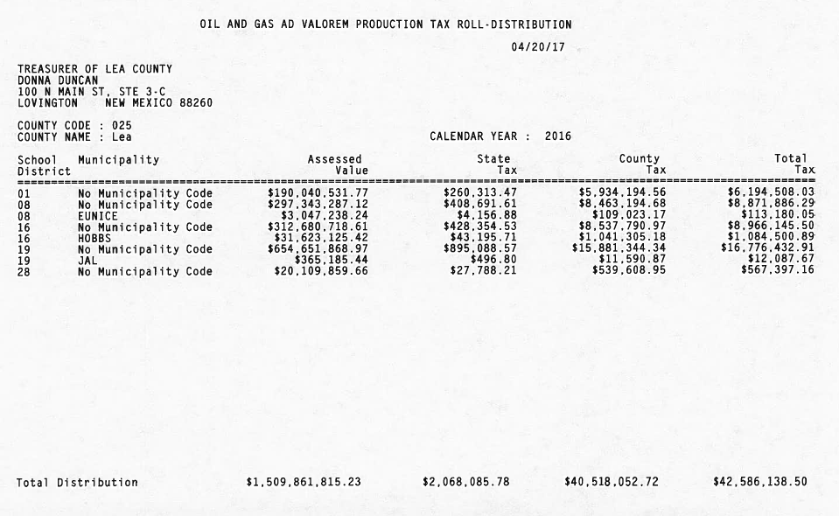
Oil and Gas Ad Valorem Production
Tax Roll-Distribution

Slide 12
Oil and Gas Annual Ad Valorem (OGAA) Tax Roll Distribution 7-38-32
The report is used with OGET by the producing counties and school districts to setup budget and bonding for the upcoming year.
The report is distributed to the producing counties and school districts in April annually.
The report is distributed via email based off of the distribution list of the prior year. Hard copies are not provided.

Slide 13
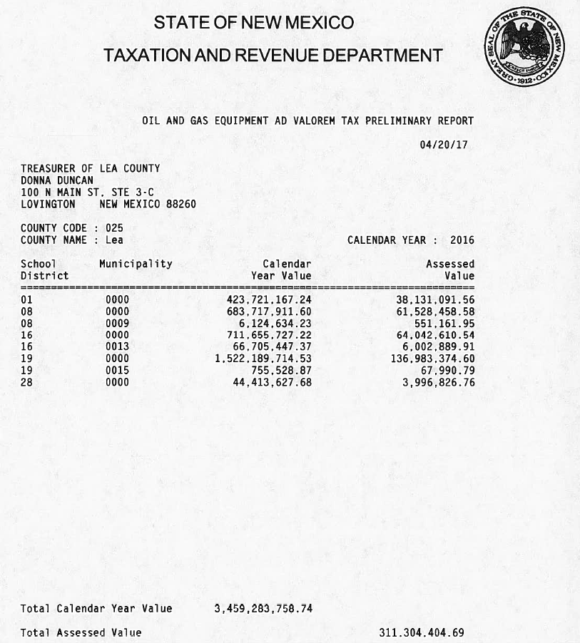
Oil and Gas Equipment Ad Valorem Tax Preliminary Report

Slide 14
7-34-4. Ad Valorem Tax Rate Changes
NMTRD provides the total “values” as reported by all tax remitters for a calendar year to the producing counties and school districts.
Data may be used in formulas to set up bonding and budgets for the next fiscal year.
Tax Certification is compiled by the Counties, the Public Education Department, Property Tax Division and issued by the Local Government Division of the Department of Finance and Administration the Oil and Gas Severance Tax Bureau. 7-38-33

Slide 15
Tax Rate changes cont..
The tax certificates are provided to the Oil and Gas Bureau.
The Bureau preps the documents with associated information for key entry by fund type into the database.
When all changes are by fund type per County, School District and Municipality that comprise the internal suffix used for distribution purposes the rates are then finalized.
Rates will be posted and distributed to all tax payers of record on or before October 15th.
The new full Ad Valorem tax rate is used to assess and issue the annual Ad Valorem Production Equipment Tax Assessment.

Slide 16
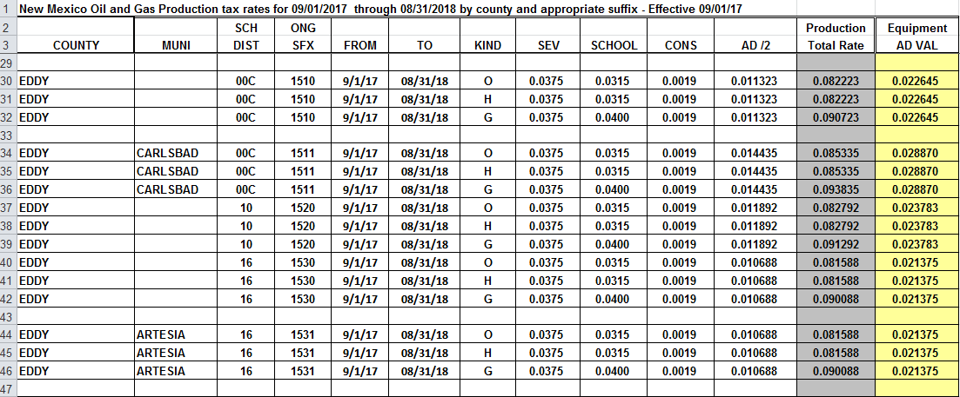
Oil and Gas Production Rates and Annual Ad Valorem Equipment Tax Rates

Slide 17
Method of determining assessed value. 7-34-3
The value of products of each production unit for the previous calendar year:
The taxable value of equipment of each production unit is an amount equal to twenty-seven percent of the value of products of each production unit.
The assessed value of equipment of each production unit shall be determined by applying the uniform assessment ratio to the taxable value of equipment of each production unit.

Slide 18
Computing the Oil and Gas Production Equipment Ad Valorem Tax 7-34-3
The assessed value is derived from all reported production for the specific property:
Gross Value less allowable deductions, multiplied by 27%, multiplied by the uniform commercial code which is 33 1/3%, multiplied by the full Ad Valorem production tax rate issued for the current year. This equals the tax due for each production unit, suffix and product.

Slide 19
Oil and Gas Production Equipment
Ad Valorem Tax Assessment
This is an ad valorem tax on equipment used in production of oil, natural gas, carbon dioxide and non-hydrocarbon gas. The tax is on the assessed value of the equipment. The assessed value of the equipment is a percentage of its value as established under the Ad Valorem Production Tax multiplied by the uniform assessment ratio.
This tax is due on or before November 30 each year.

Slide 20
Oil and Gas Production Equipment
Ad Valorem Tax Assessments
  Assessments are generated annually.
  Issued to all Master Operators of record
  They are based on the reported taxes of all taxpayers that remit to a Master Operator’s Production Unit Numbers PUN(s)
  Assessments are due on November 30 or the next business day should the 30th fall on a weekend or holiday.

Slide 21
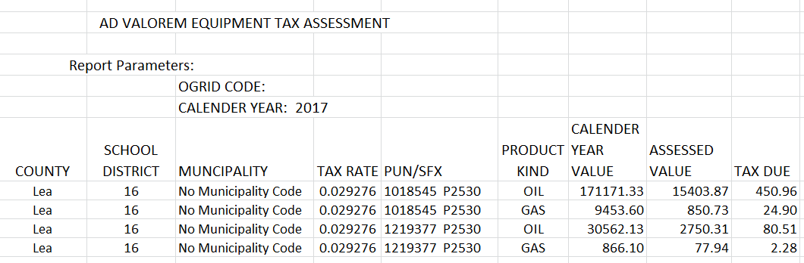
Ad Valorem Equipment Tax Assessment Example:

Slide 22
Other Important Information
The Oil and Gas Severance Tax Bureau is not required to track mineral interest owner information.
Mineral Interest owners requesting information should inquire with the county where the mineral interest is located.
Other resources to obtain this information are attorneys or land men who specialize in researching mineral interests.

Slide 23
Oil and Gas Severance Tax Bureau
Toll free contact number as of Mar 19, 2018: 866-285-2996, select option 2
Email us at:
  Oilgas.outreach@state.nm.us
  Presented by the Oil and Gas Severance Tax Bureau:
  Judy Vigil, Bureau Chief
  Maureen Pasquier, Staff Manager

