Slide 1
Insurance Premium Tax (IPT)
Webinar
March 20, 2020

Slide 2
Introduction
Welcome from New Mexico Taxation & Revenue Department
Invitees include:
Insurance Companies
Insurance Brokers
Stakeholders in IPT
Presenters:
Lisa Trujillo, Deputy Director of Audit and Compliance Division
Melissa Acevedo, Accountant/Auditor
A host of others who may help answer questions

Slide 3
Agenda
Insurance Premium Tax Legislative Overview
Tax Administration Act (TAA)
Registration
TAP Account Administrator
Filing and Paying
Payment Methods
Penalty and Interest
Refunds
Taxpayer Access Point (TAP)
Who to contact
Additional questions and answers

Slide 4
Legislative Overview
Insurance Premium Tax Act:
Enacted by House Bill 223 went into effect January 1, 2020
This bill transferred the duty to collect insurance premium taxes from the Office of the Superintendent of Insurance to the Taxation and Revenue Department (TRD); creating the Insurance Premium Tax Act.
Section 7, Article 40 NMSA 1978 under the Tax Administration Act (TAA) authorizes the Department to administer the tax

Slide 5
Tax Administration Act
The Taxation and Revenue Department (TRD) administers various tax and fee acts. The
Tax Administration Act contains all of the administrative statutes for these acts.
All of this information can be found on the WWW.tax.newmexico.gov website.
The website breaks down the information by various acts.

Slide 6
Registration
The Department has registered your business based off the registration data provided by the Office of the Superintendent of Insurance (OSI).
Under Taxation and Revenue all registrations are required to include a Federal Employer Identification Number (FEIN), Employer Identification Number (EIN) or Social Security Number (SSN).
The entity type (Corp, Sole Corp, LLC, Individual etc.) drives which type of number will be requested if not identified during the transition of registrations from OSI to TRD.

Slide 7
Insurance Premium Life
and Health Tax
The Insurance Premium Life and Health tax has been assigned an acronym which will be used in the new tax filing system (TAP) to identify the tax program
The Insurance Premium Life and Health tax program will be referred to as IPH

Slide 8
Insurance Premium Casualty,
Property, and Vehicle Tax
The Insurance Premium Casualty, Property, and Vehicle tax has been assigned an acronym which will be used in the new tax filing system (TAP) to identify the tax program.
The Insurance Premium Casualty, Property, and Vehicle will be referred to and identified using IPP

Slide 9
Insurance Premium Surplus
Lines Tax
The Insurance Premium Surplus Lines Tax has been assigned an acronym which will be used in the new tax filing system (TAP) to identify the tax program.
The Insurance Premium Surplus Lines Tax will be referred to and identified using IPS

Slide 10
Return & Payment Due Dates
The IPT Quarterly returns and payment are due quarterly by the 15th day of the following month subsequent to each calendar quarter.
For example:
The IPT Annual return is due on the 15th of April.
Filing a return or making a payment after the due date will result in penalty and interest accruing on any unpaid balance from the day after the due date until a filed return and payment is made in full as per 7-1-69 & 7-1-67 NMSA 1978. For details see Penalty & Interest Rates at tax.newmexico.gov.
*If the 15th falls on a weekend or holiday, the file & payment are considered timely the next available business day as per 7-1-77 NMSA 1978. Mailed payments shall be considered timely if postmarked on the next succeeding day which is not Saturday, Sunday, or a national holiday as per 3.1.4.10 NMAC.

Slide 11
Insurance Premium Surplus
Lines Tax
Coming Soon:
The Insurance Premium Surplus Lines Tax is part of Phase II of the Insurance Premium Tax project.
Surplus Lines Due Dates:

Slide 12
TAP Account Administrator
The account administrator will have access to file the Insurance Premium tax returns.
The account administrator may grant access to an employee, accountant, bookkeeper etc. to file on behalf of the company.
For security reasons, please do not share a log-on and password.

Slide 13
Filing & Paying IPT
We will cover:
Taxpayer Access Point (TAP) registration and log in
Submitting your IPT quarterly and annual return.
Penalty and Interest
Requesting a refund of overpayment

Slide 14
Payment Methods
Electronic payments-ACH debit/e-check (no service fee) using TAP.
Credit card payments, subject to a 2.4% convenience fee imposed by the credit card company using TAP.
Automatic clearing house and federal wire transfer payments (initiated through your financial institution)
Refer to Publication FYI 401 for special payment methods. This can be found @www.tax.newmexico.gov

Slide 15
Penalty and Interest
The Insurance Premium Tax program is subject to TAA and will follow the guidelines for assessing penalty and interest per Article 7-1-69 NMSA 1978.
Penalty is assessed at a rate of 2% per month or partial month not to exceed 20%. Interest accrues daily; and can change on a quarterly basis. For detail see Penalty and interest rates at www.tax.newmexico.gov for annual and daily interest rates.

Slide 16
Requesting a Refund
Refund Request Options:
Refunds will be processed by the Department using form
RPD-41071, Application for Refund.
The paper application must be accompanied by all supporting documents.
If the refund is based off of an annual return, you must first file the return via TAP or it must accompany the return.
Refunds may also be requested via TAP (note: the credit must be displayed in TAP on the account to submit the request.
Refund transfer requests may be submitted via TAP (a request to apply the credit balance to a future period or balance.
Supporting documents may be attached to the refund request in TAP.

Slide 17
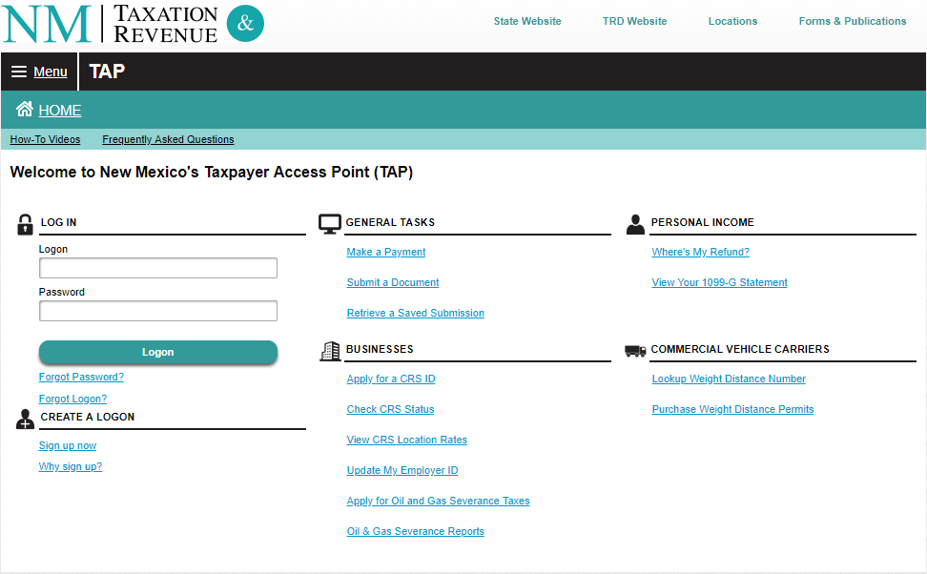
TAP Demonstration
https://tap.state.nm.us/TAP

Slide 18
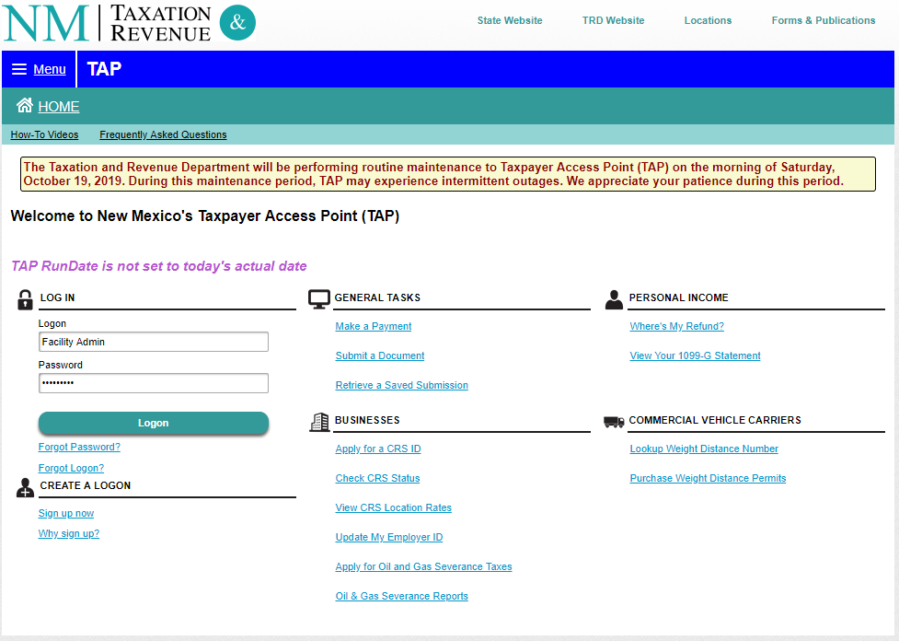
TAP Logon

Slide 19
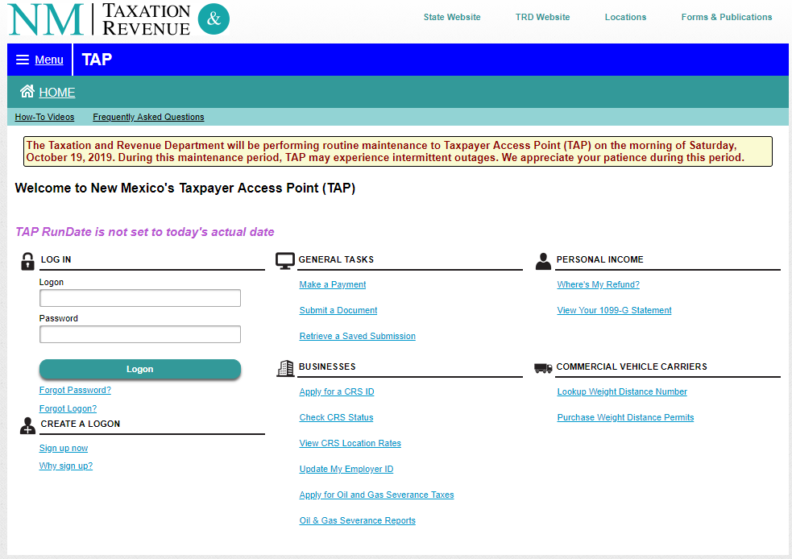
Registering for TAP

Slide 20
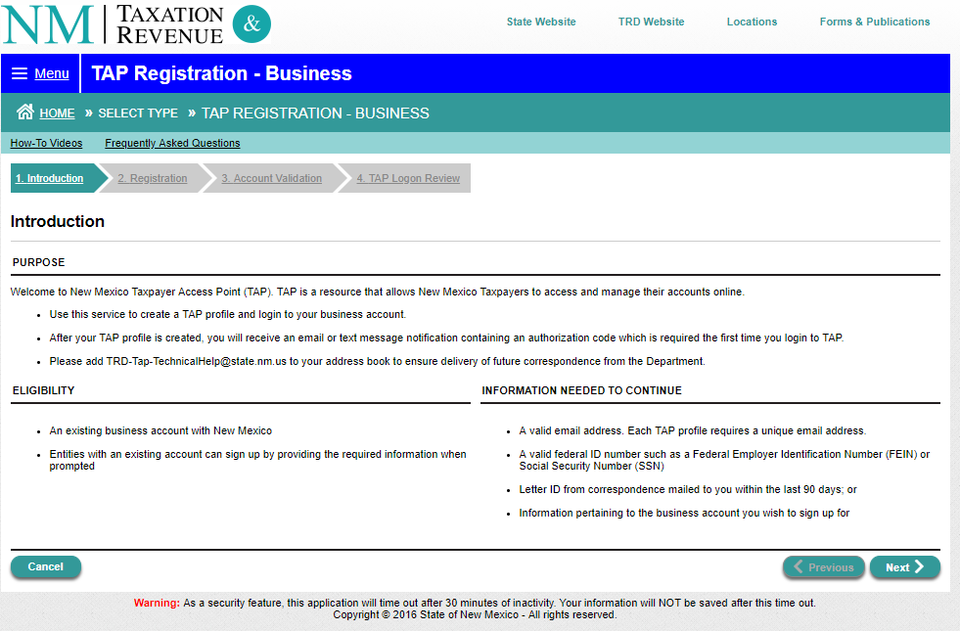
Registering for TAP
(Introduction screen)

Slide 21
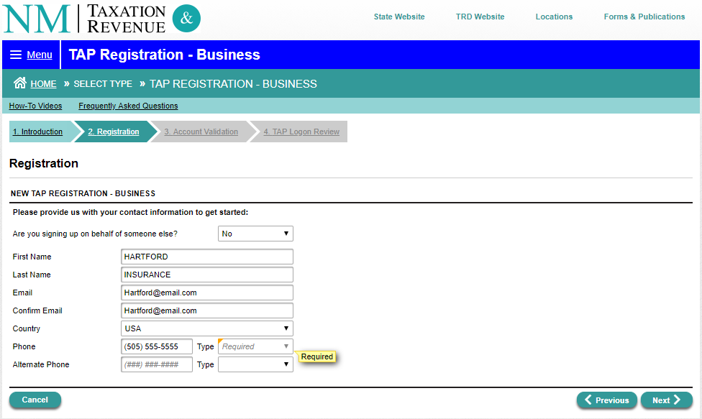
Registering for TAP

Slide 22
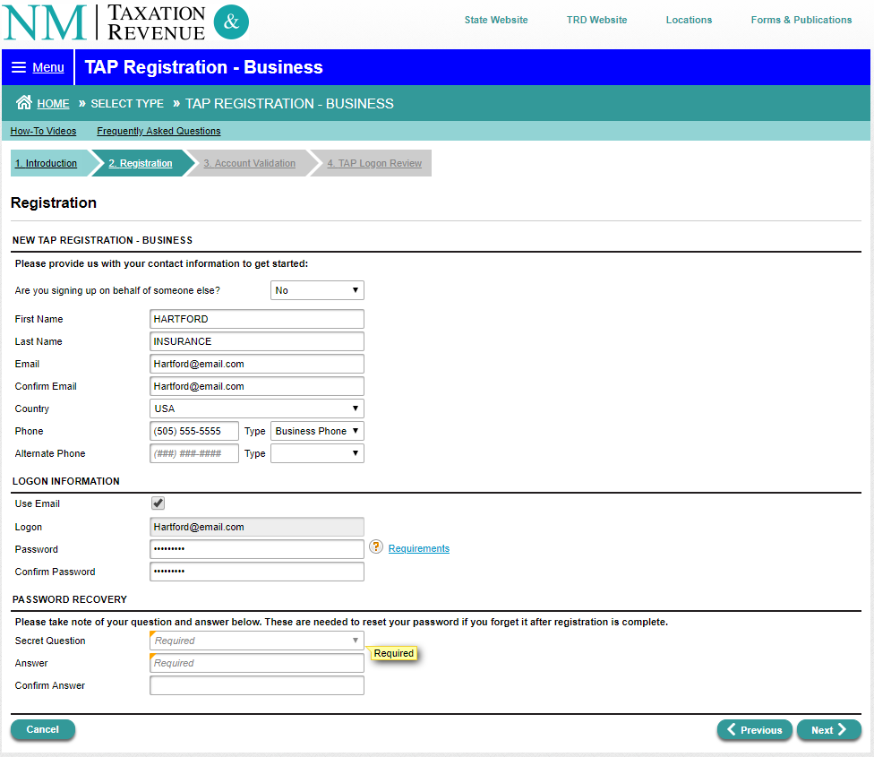
Registering for TAP

Slide 23
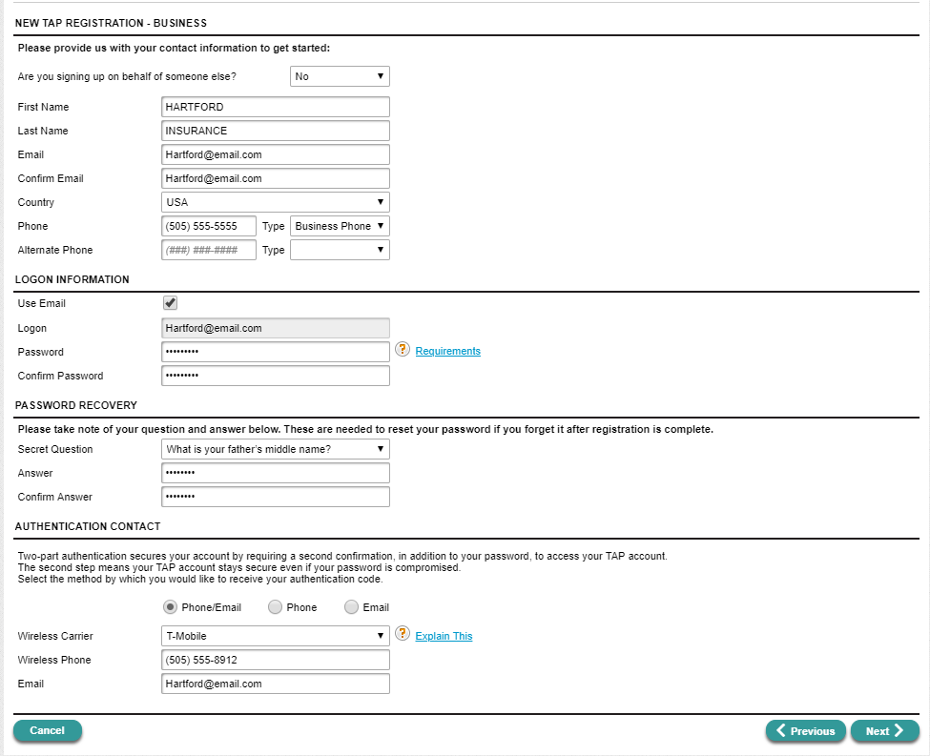
Registering for TAP
(Completed registration screen)

Slide 24
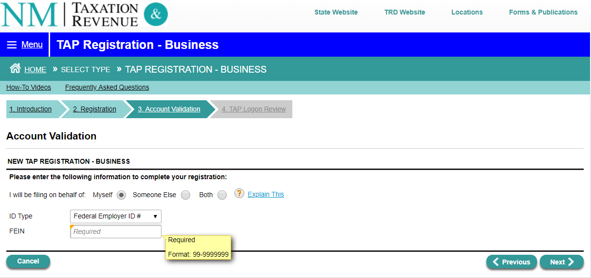
Registering for TAP
(Account validation screen)

Slide 25
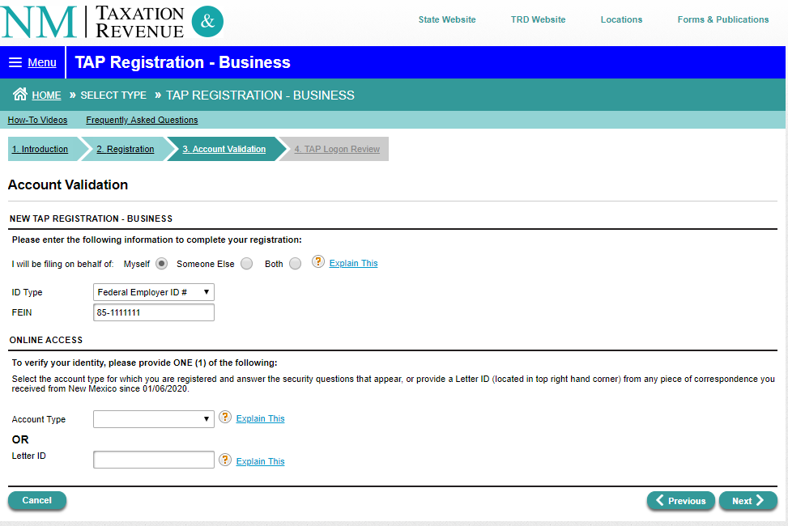
Registering for TAP

Slide 26
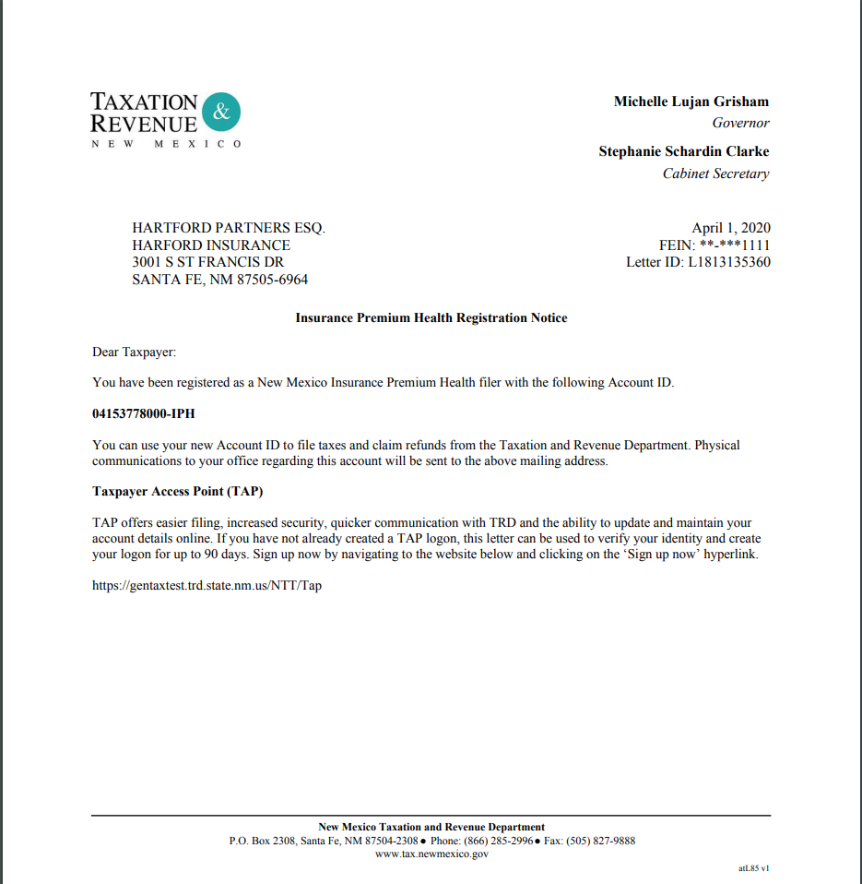
Registering for TAP

Slide 27
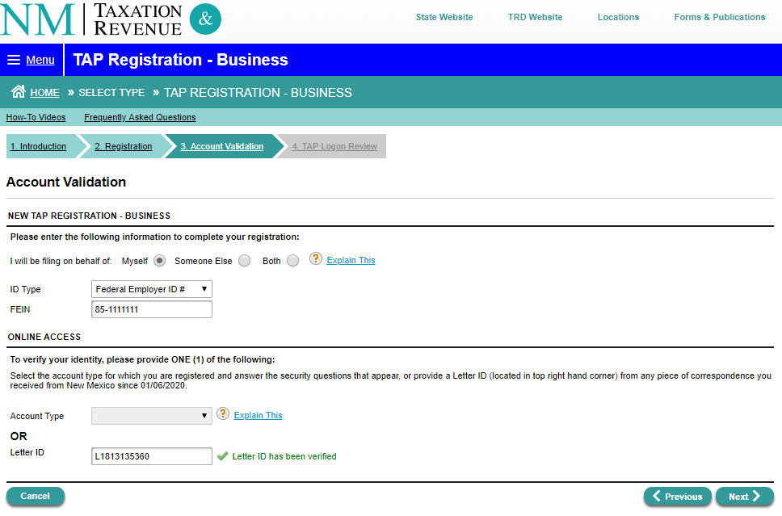
Registering for TAP

Slide 28
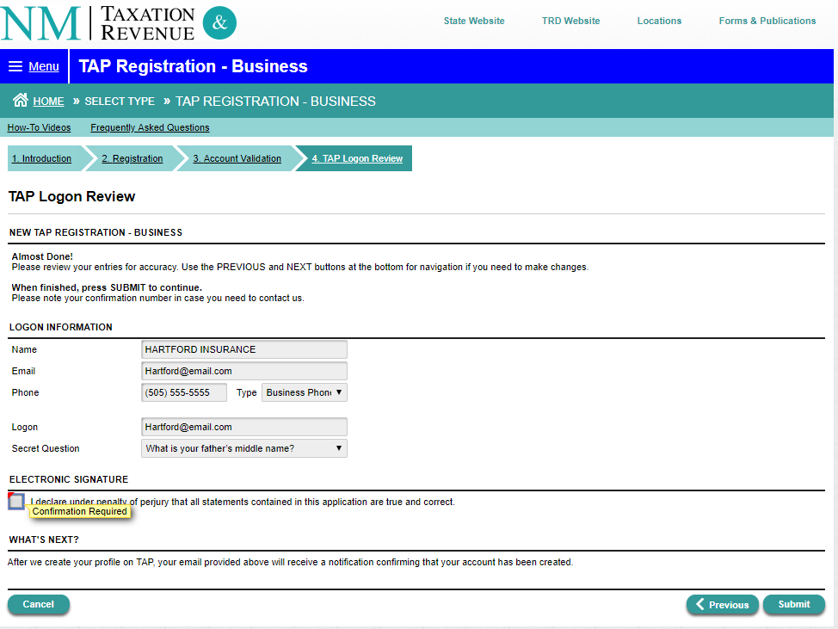
Registering for TAP

Slide 29
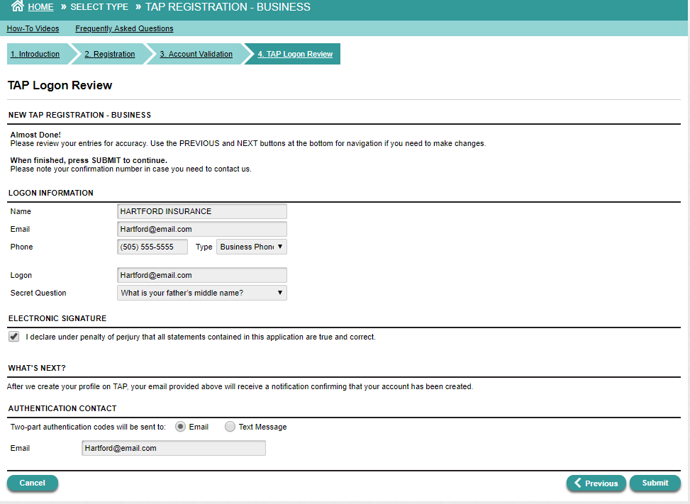
Registering for TAP

Slide 30
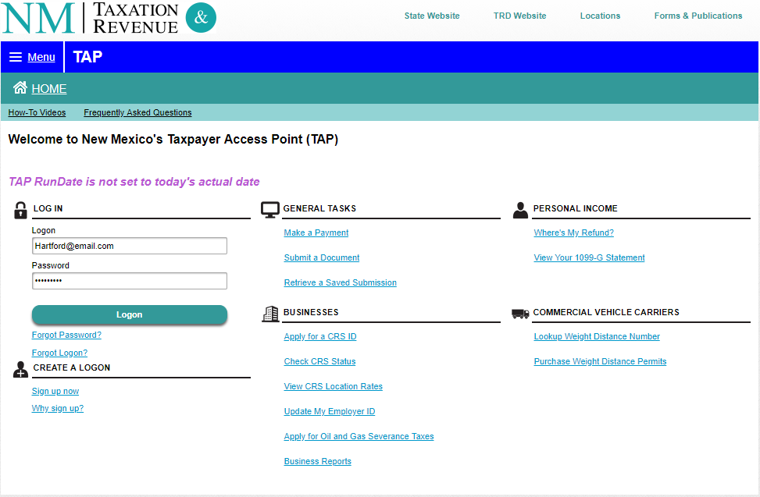
Log on to TAP

Slide 31
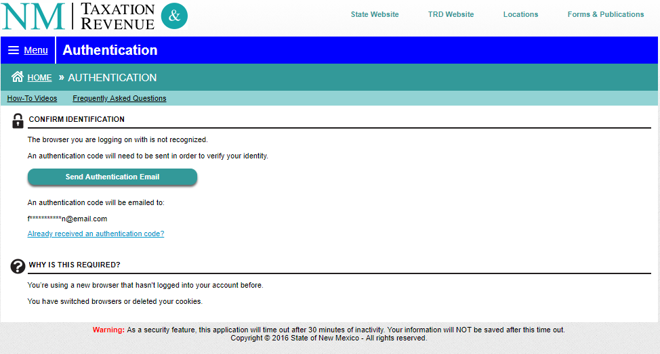
Log on to TAP

Slide 32
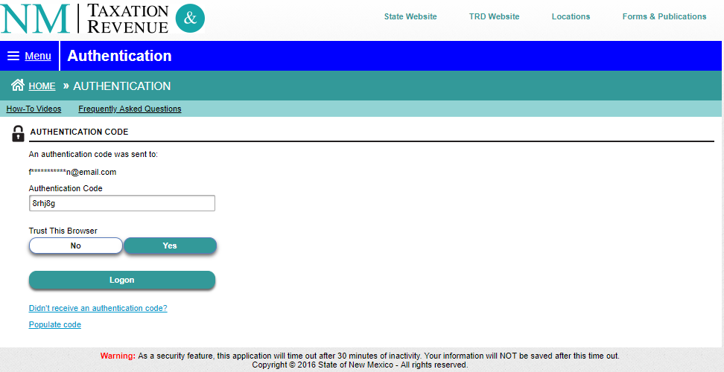
Log on to TAP

Slide 33
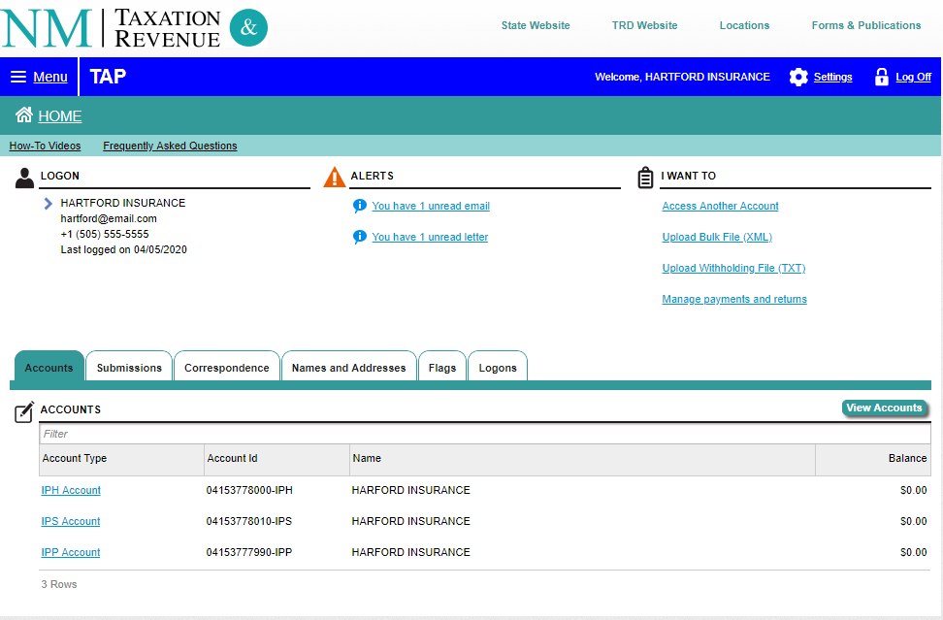
TAP Home Page

Slide 34
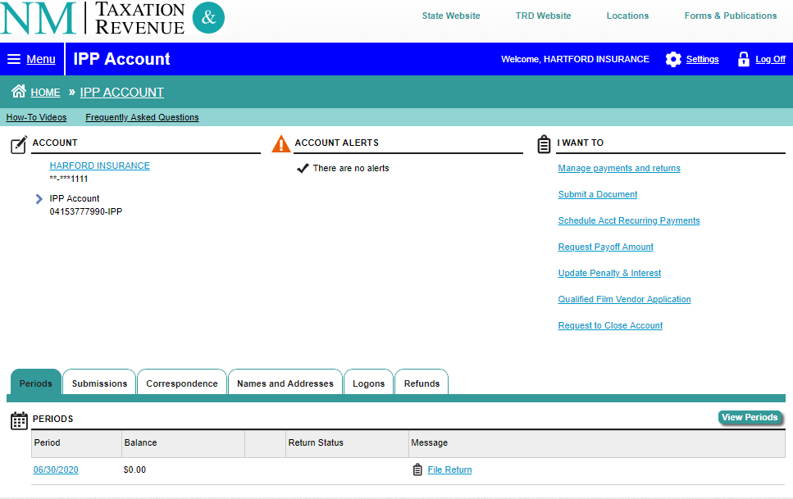
Filing IPT Return

Slide 35
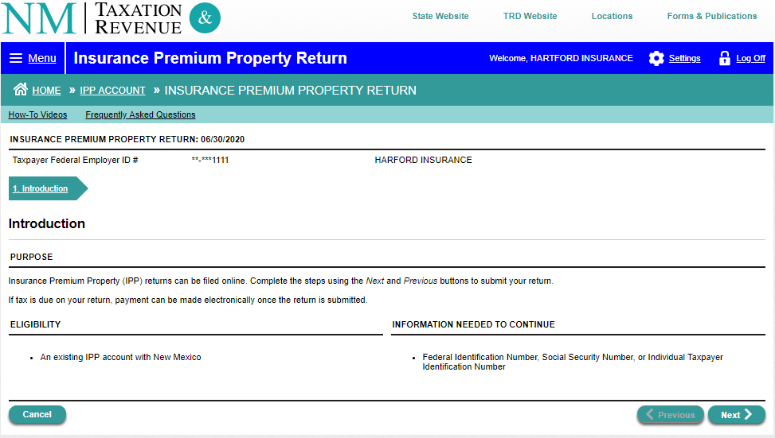
Filing IPT Initial Return

Slide 36
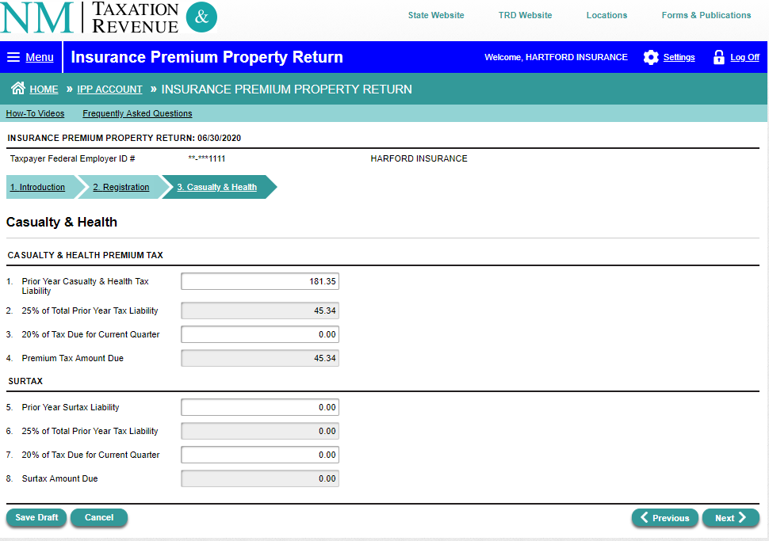
Filing IPT Initial Return

Slide 37
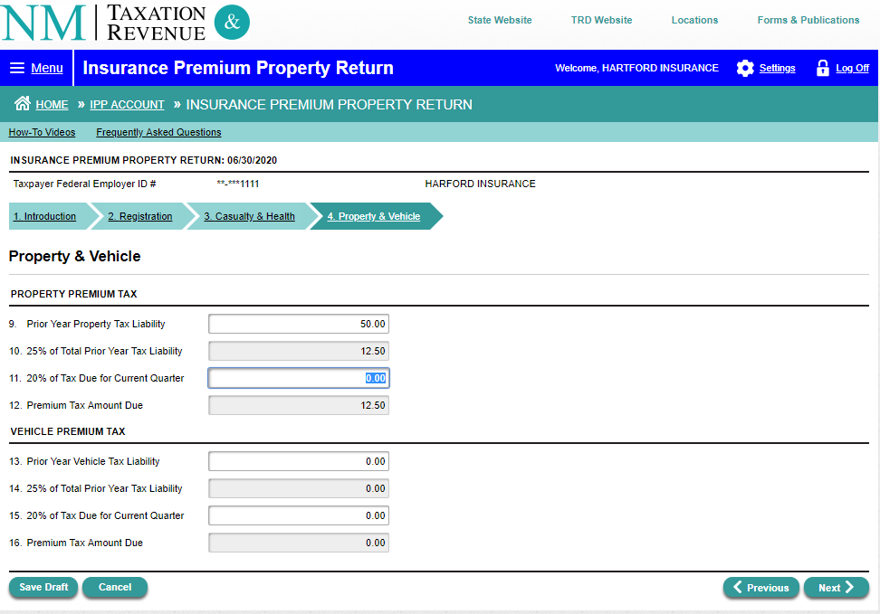
Filing IPT Initial Return

Slide 38
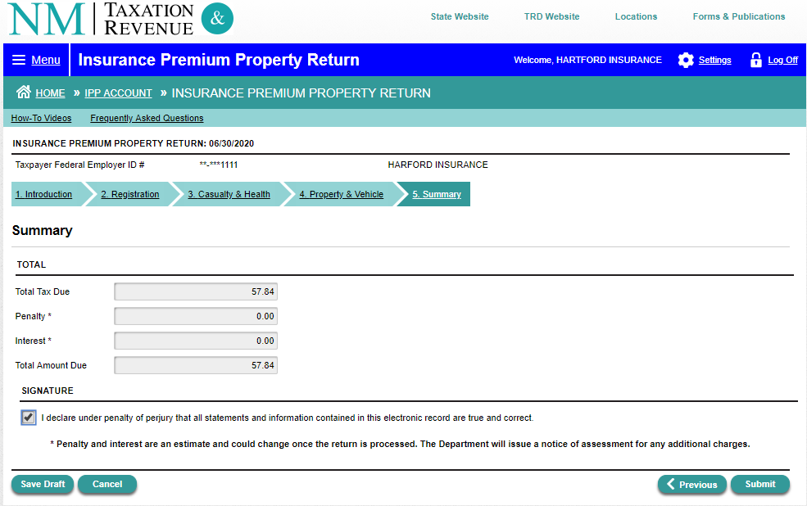
Filing IPT Initial Return

Slide 39
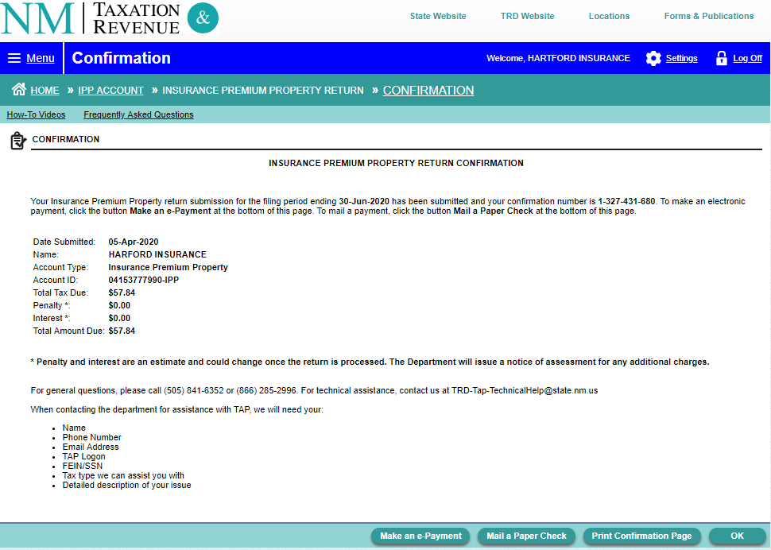
IPT Confirmation Page

Slide 40
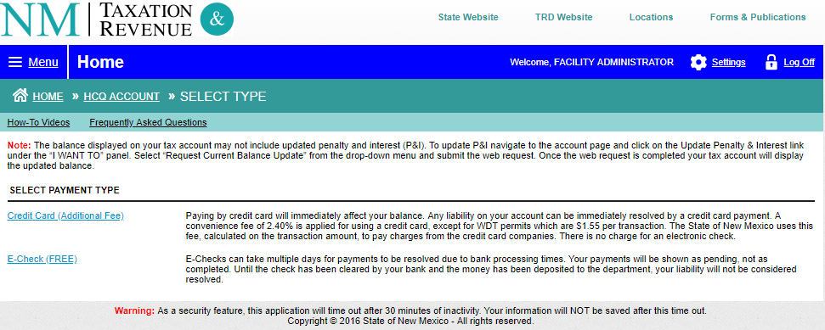
Paying IPT Initial Return

Slide 41
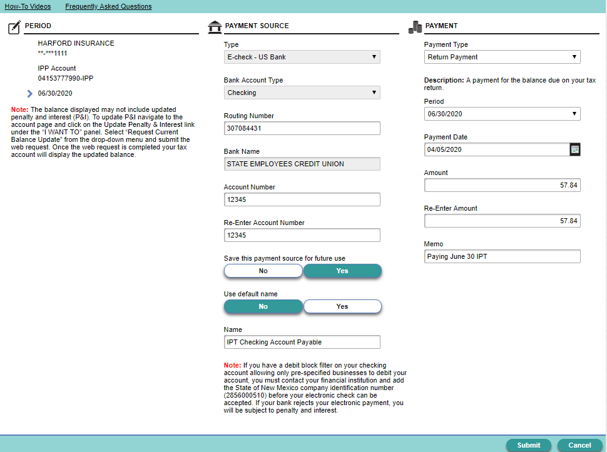
Paying IPT Initial Return

Slide 42
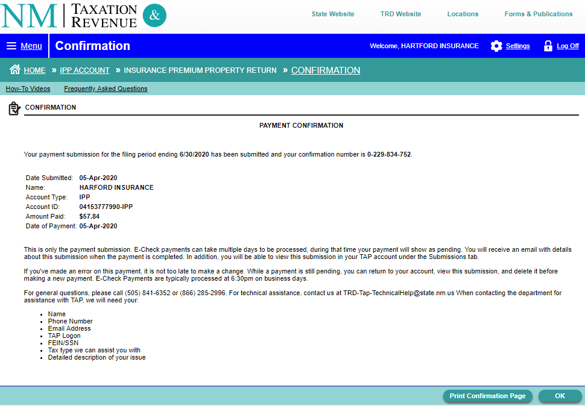
IPT Payment Confirmation

Slide 43
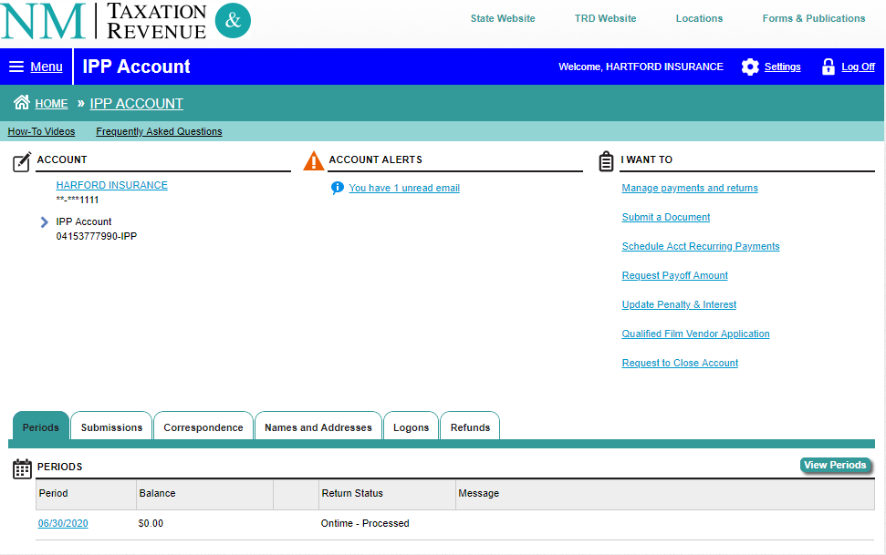
IPT Return Status

Slide 44
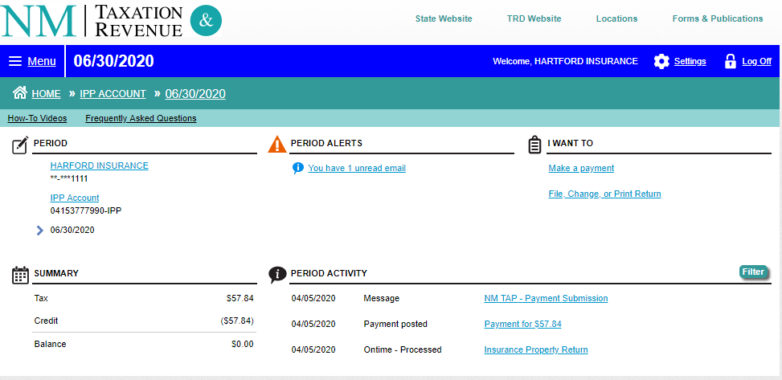
Payment and Return Status

Slide 45
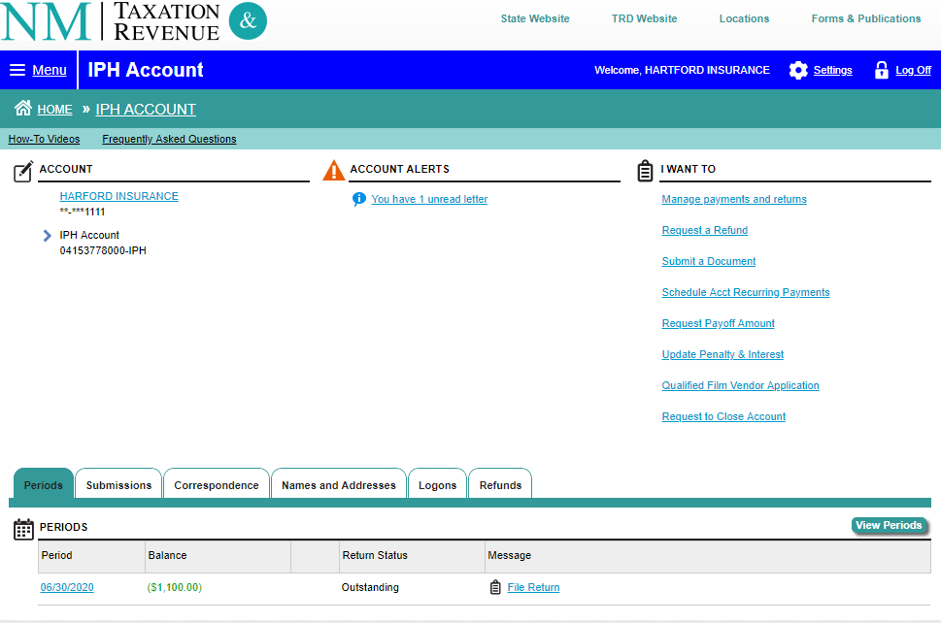
Requesting Refund

Slide 46
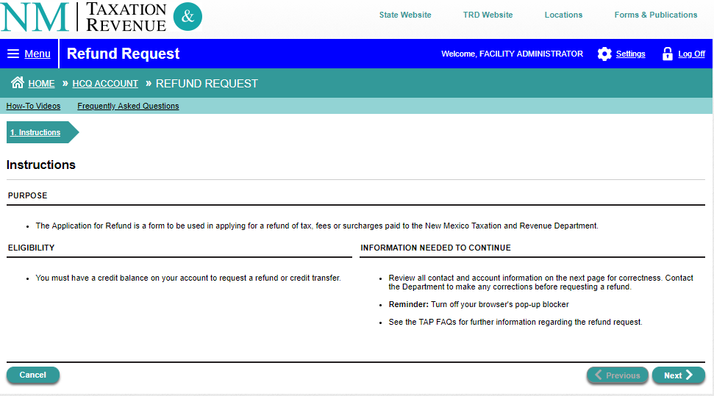
Refund Introduction Screen

Slide 47
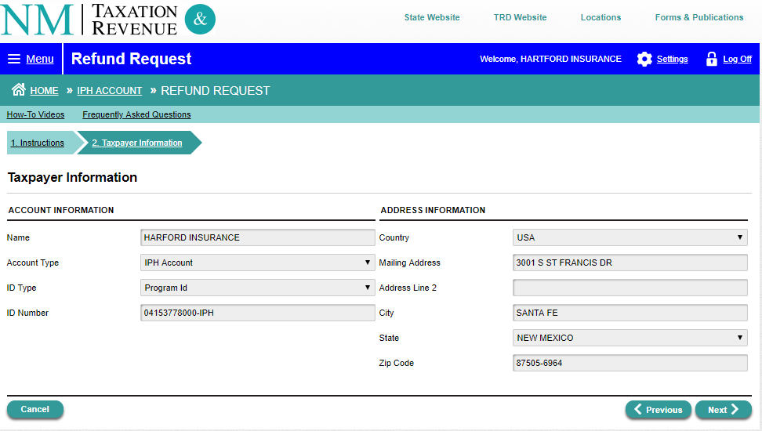
Requesting Refund

Slide 48
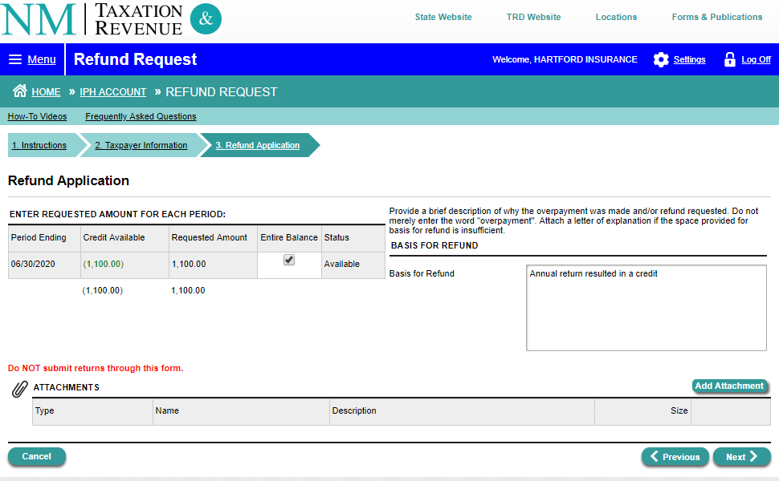
Requesting Application

Slide 49
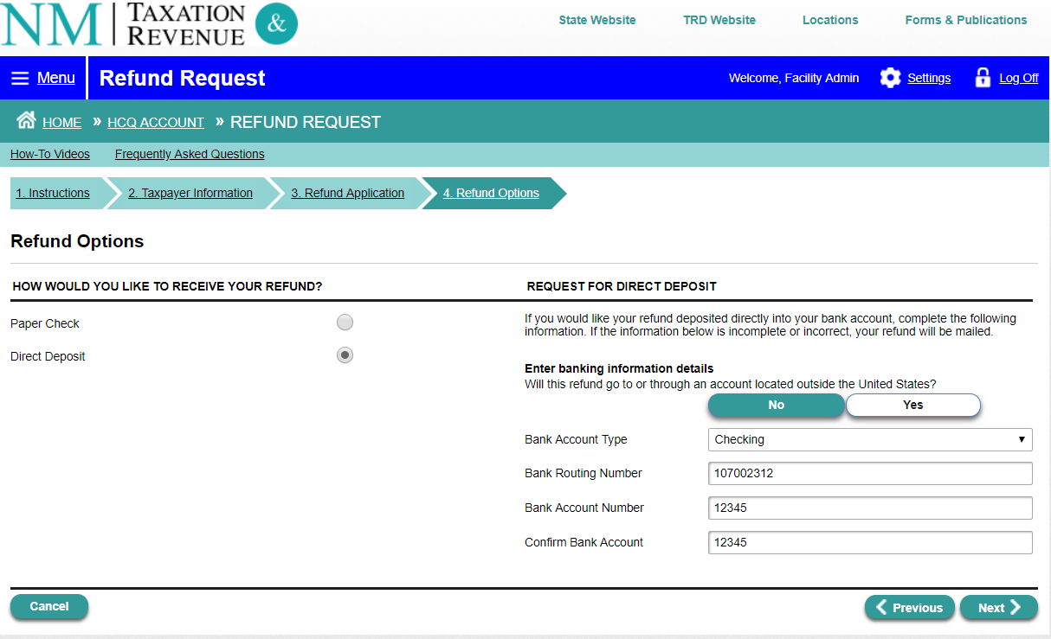
Requesting Options

Slide 50
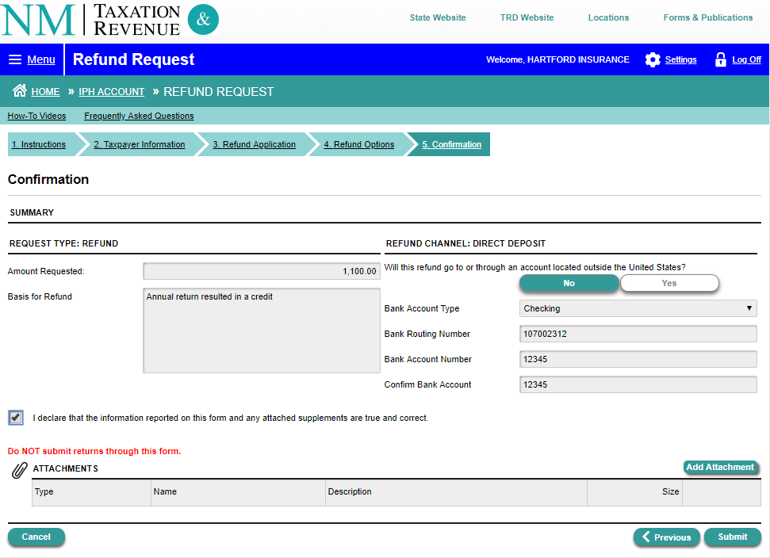
Refund Confirmation

Slide 51
Q & A

Slide 52
Contact
Contact us via Telephone
Submit a Service Pro ticket to:
New Mexico Taxation & Revenue (TRD)
Insurance Premium Tax
Telephone: (866) 285-2996
New Mexico Taxation & Revenue IPT Email:
Insurancepremium.outreach@state.nm.us

